Slide 1
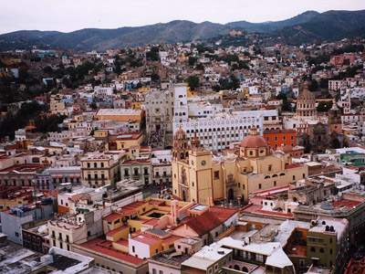
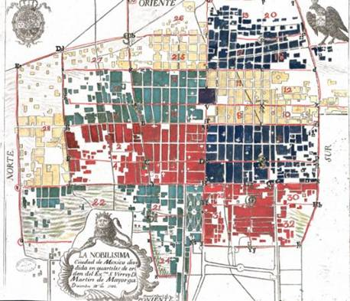
Latin America City Analysis
Colonial cities followed standardized plans.
All Spanish cities in Latin America, for example, were built according to the Laws of the Indies, drafted in 1573.
Cities were to be constructed (on) a gridiron street plan centered on a church and central plaza, and neighborhoods centered around smaller plazas with parish churches or monasteries.
After the Spanish conquered Tenochtitlán they destroyed the city, and dispersed or killed most of the inhabitants.
The city renamed Mexico City, was rebuilt around a main square, called the Zócalo, in the center of the island, on the site of the Aztecs’ sacred precinct.
The Spanish reconstructed the streets in a grid pattern extending from the Zócalo.

Slide 2
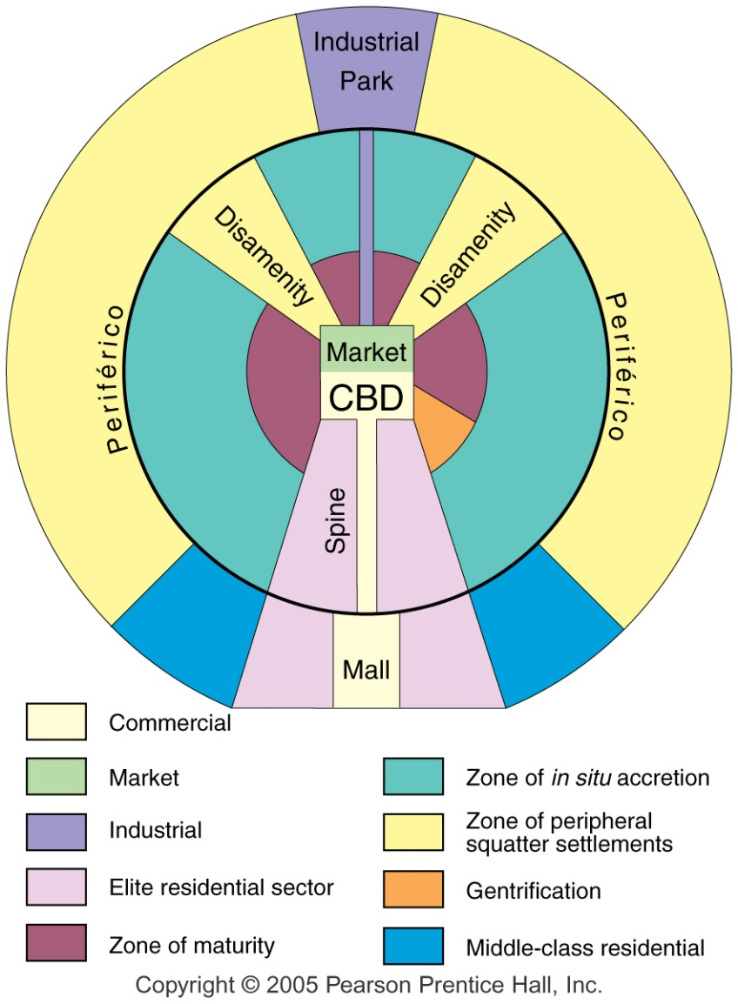
Latin American City Model
Fig. 13-15: In many Latin American cities, the wealthy live in the inner city and in a sector extending along a commercial spine.

Slide 3
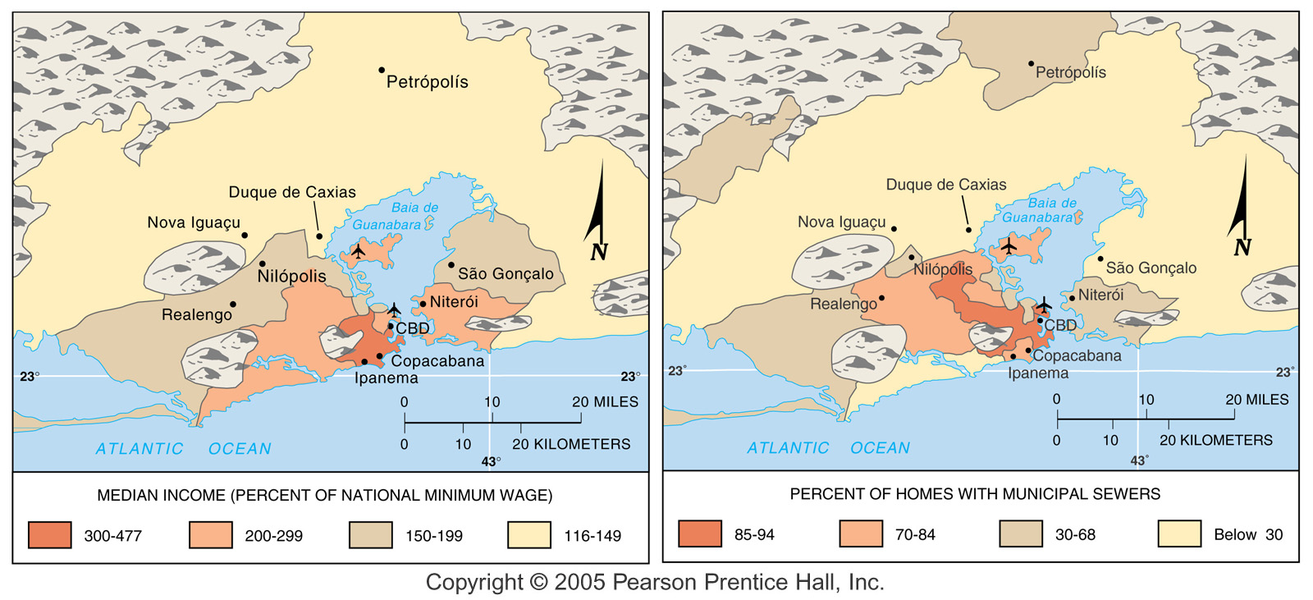
Rio de Janeiro, Brazil
Fig. 13-16: High income households in Rio de Janeiro live in the CBD and in a spine along the ocean. Low-income households often live in peripheral areas.

Slide 4
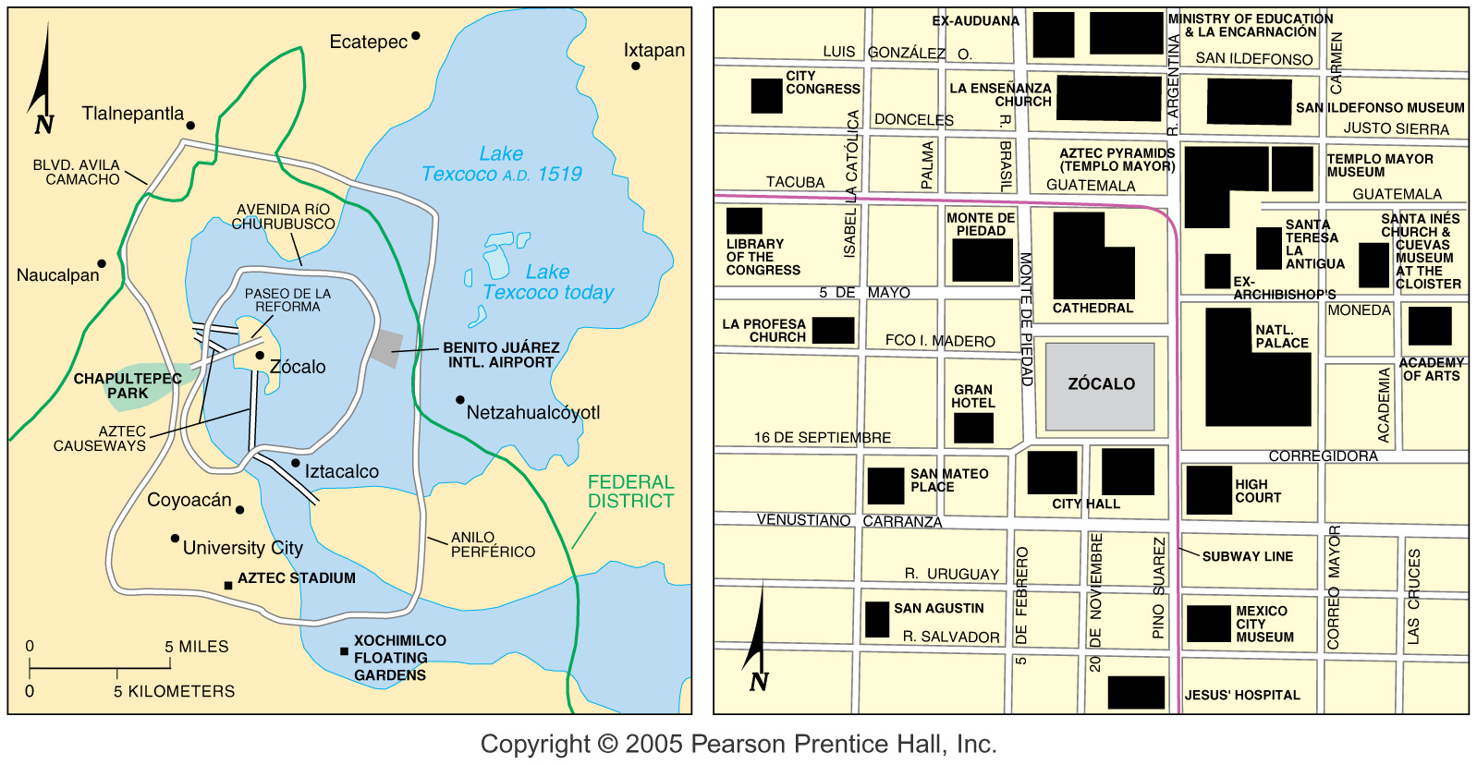
Mexico City
Fig. 13-12: The Aztec city of Tenochtitlán was built on an island in Lake Texcoco. Today poorer people live on a landfill in the former lakebed, and the elite live to the west.

Slide 5
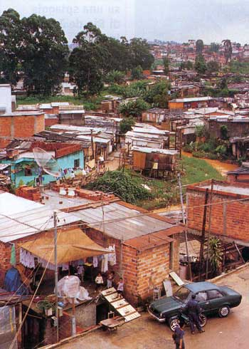
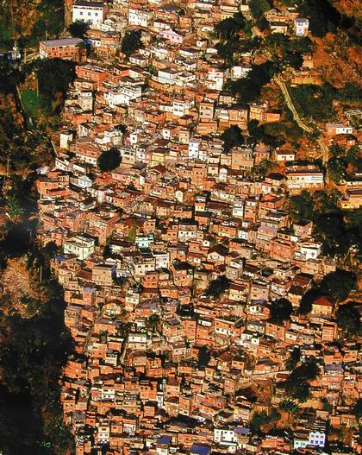
Squatter Settlements
The LDCs are unable to house the rapidly growing number of poor.
A large percentage of poor immigrants to urban areas in LDCs live in squatter settlements.
Squatter settlements have few services, because neither the city nor the residents can afford them.
Electricity service may be stolen by running a wire from the nearest power line.
In the absence of bus service or available private cars, a resident may have to walk two hours to reach a place of employment.
At first, squatters do little more than camp on the land or sleep in the street.
Families then erect primitive shelters with scavenged (materials).
The percentage of people living in squatter settlements, slums, and other illegal housing ranges from 33 percent in São Paulo, Brazil, to 85 percent in Addis Ababa, Ethiopia, according to a U.N. study.

