Slide 1
Module 3.2 Media and Propaganda
Directions: The media does a lot to influence public opinions and belief…especially in politics.
View the following ads which are examples of the 7 different types of propaganda.
Home work: You are assigned a type of propaganda. Using YouTube, locate a “clean” advertisement or political ad that uses your type of propaganda. Once you have located an example, save it to your school number or e-mail and load the URL for your example to the main board. Be sure and provide the type of propaganda that is being used as well as your name. Please make sure that your example is “clean”.
Thursday: work with a partner to develop a 1-2 minute “skit” that teachers your propaganda type without just reporting about the commercial you found. You will get up and share this…

Slide 2
Band Wagon

Slide 3
Loaded Words
(Sometimes called “card stacking”)

Slide 4
Testimonials

Slide 5
Plain Folks

Slide 6
Transfer

Slide 7
Name Calling

Slide 8
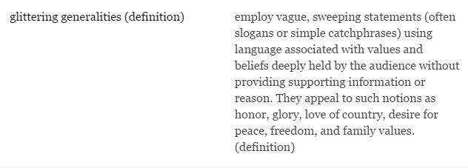
Glittering Generalities

Slide 9
Types of Media Propaganda | The Definition | An Example
Band Wagon
Loaded Words
Testimonials
Plain Folk
Transfer
Name Calling
Glittering Generalities

